Slide 1
Climate Change in The United States
PyWeatherman
Data Analytics Project
Sumeet Dhawan, Kafui Ahedor
Chris Bock, Suraj Thyagaraj
Notes:
CB
Hello and welcome to Climate Change in the United States, a PyWeatherman data analytics project.
I’m Chris Bock and joining me today are Sumeet Dhawan, Kafui Ahedor and Suraj Thyagaraj

Slide 2





Introduction
Climate change is affecting every country on every continent.
It is disrupting national economies affecting lives, costing people, communities and countries today and even more tomorrow.
Weather patterns are changing, sea levels are rising, weather events are becoming more extreme and greenhouse gas emissions are now at their highest levels in history.
Notes:
CB
Climate change is affecting every country on every continent. It is disrupting national economies and affecting lives on a global scale, and it could get even worse. Weather patterns are changing, sea levels are rising, weather events are becoming more extreme and greenhouse gas emissions are their highest levels in history. In fact, the Paris Climate Accord has stated that “Limiting global warming to 1.5ºC compared to 2ºC (just a half degree difference) could ensure a more sustainable and equitable society”

Slide 3

Introduction
The United Nations organization (UN) provides a blueprint for peace and prosperity for people and the planet, for now and into the future, called Sustainable Development Goals (SDGs)
Notes:
ST

Slide 4
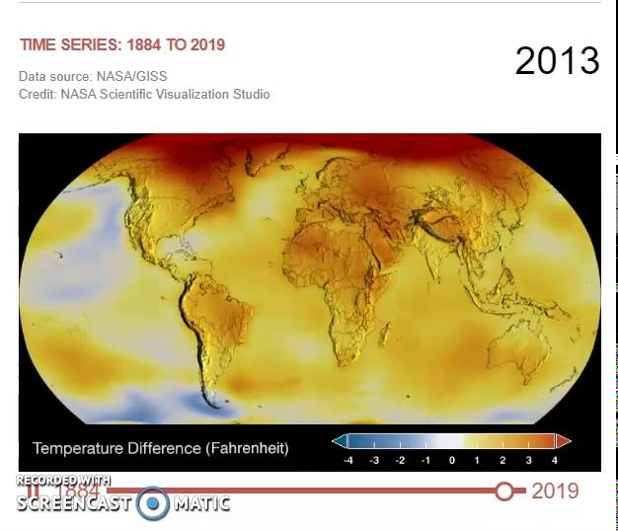
Relevance of Study
Rising temperatures:
Melting Ice
Rise in sea level
Shifts in weather patterns
Catastrophic weather events
Notes:
ST
Osaka, Japan,
Shanghai, China
Rio de Janeiro, Br
Miami,
NJ - Hoboken and Atlantic City
Key West FL
Galveston TX
Millions of displaced inhabitants and tens of billions in losses

Slide 5
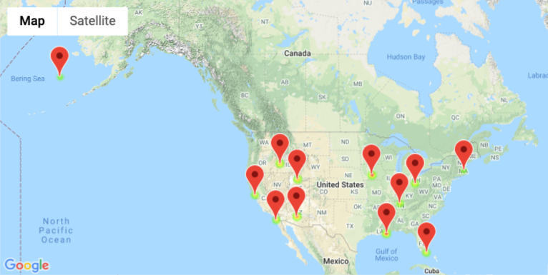
Study Objectives
Use the tools from class for an analysis of US historical weather data
Collect
Organize
Analyze
Display
Identify Significant change (Rise/Drop) in temperature
Use statistical testing to confirm trends
Notes:
KA

Slide 6
Methods
Data Collection
Data Cleanup
Data Visualization
Statistical Analysis
Meteostat API
Google Maps API
Pandas
Excel
Matlab
Seaborn
Gapminder
Matplotlib
Gmaps
Pandas
Scipy stats
T-test
Regression fitting
Notes:
KA

Slide 7
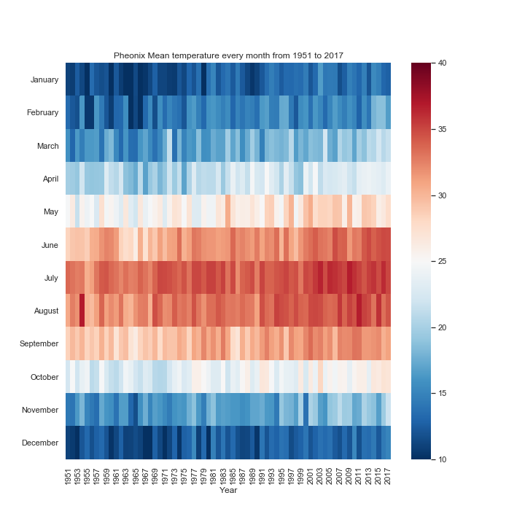
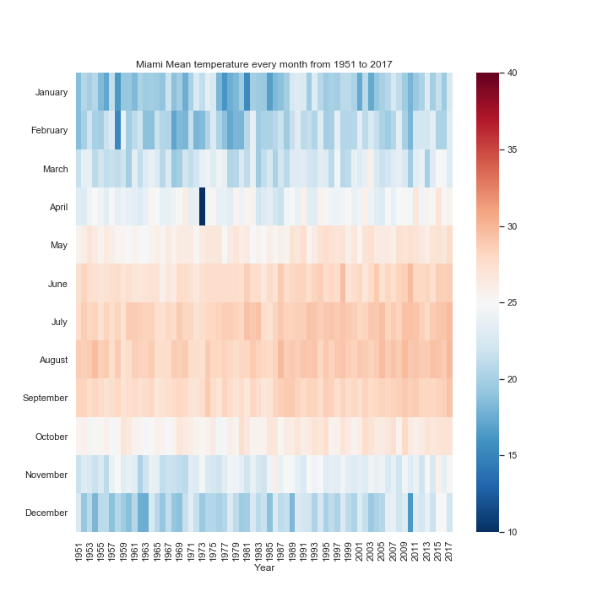
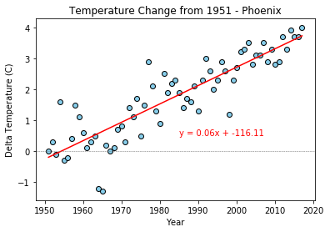
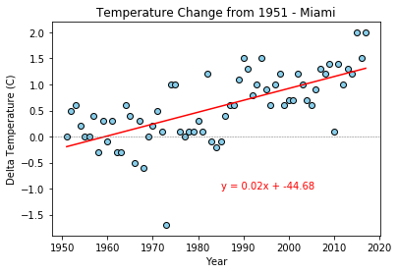
Visualizing Weather Trends
Data Vis (Phoenix and Miami)
Seeborn Heatmap + Matplotlib Scatter + Regression - PHX
Seeborn Heatmap + Matplotlib Scatter + Regression - MIA also SFO, SLC
r-squared = 0.88
r-squared = 0.67
Notes:
SD
Comments: Heat map of miami has one bad point in april;

Slide 8
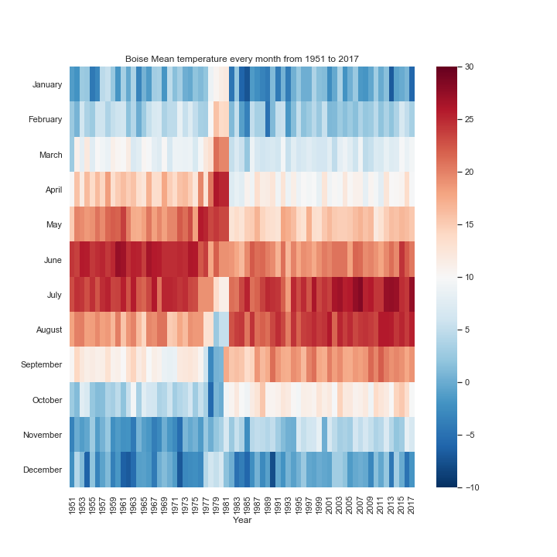
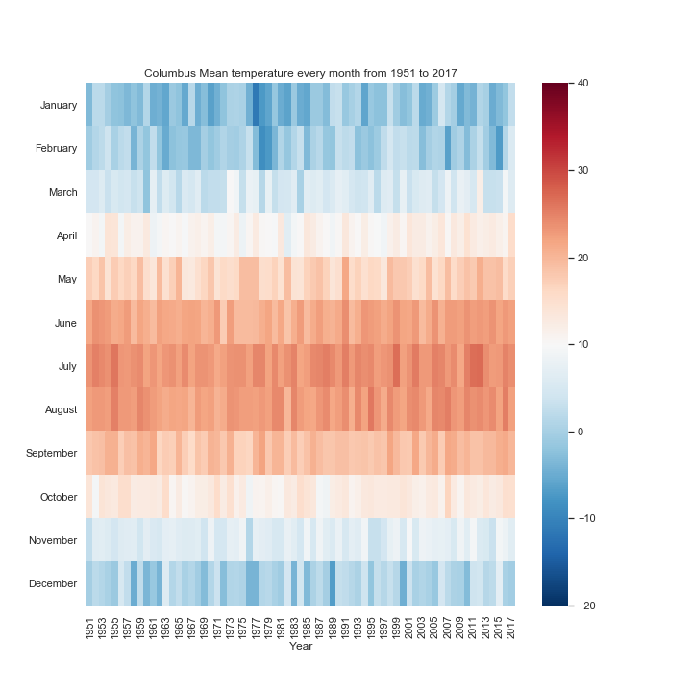
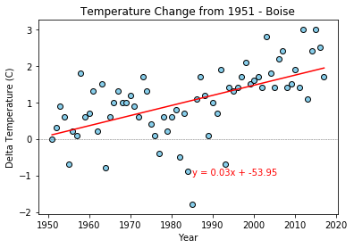
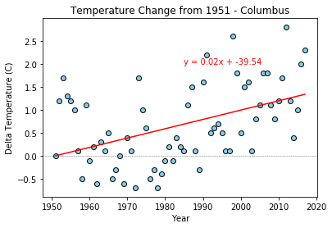
Visualizing Weather Trends
Data Vis-II
Seeborn Heatmap + Matplotlib Scatter + Regression - COL
Seeborn Heatmap + Matplotlib Scatter + Regression - BOI
r-squared = 0.57
r-squared = 0.46
Notes:
SD
columbus does not have the line equation
Boise-Shift in season clearly visible

Slide 9
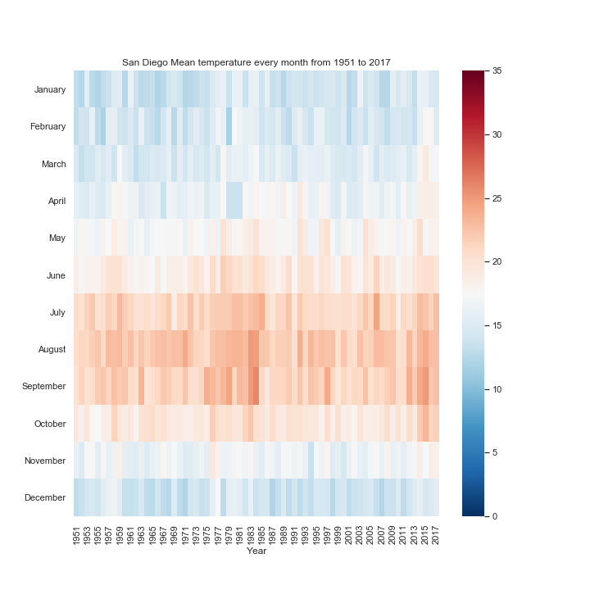
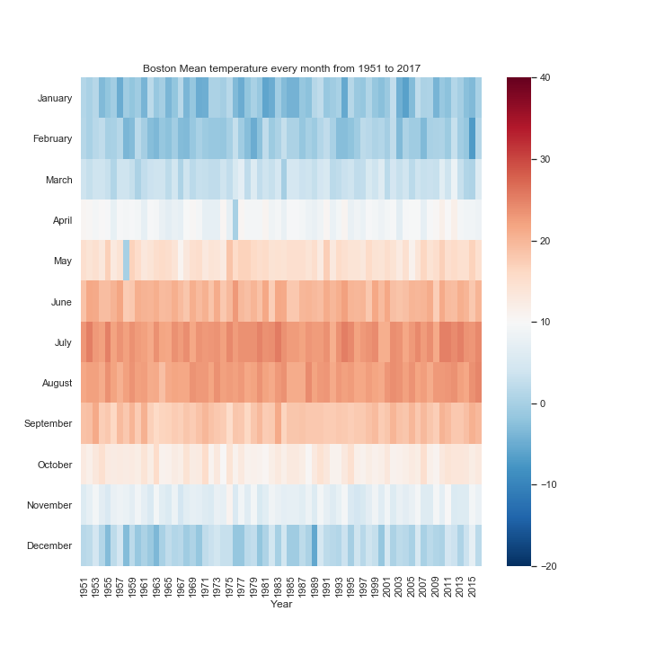
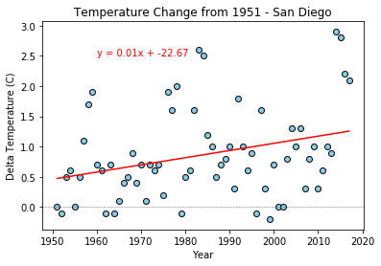
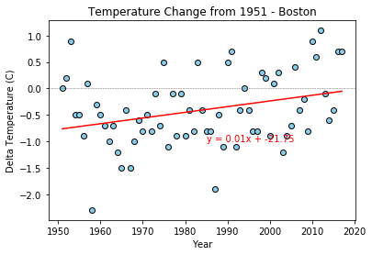
Visualizing Weather Trends
Data Vis-III
Seeborn Heatmap + Matplotlib Scatter + Regression - SDG
Seeborn Heatmap + Matplotlib Scatter + Regression - BOS
r-squared = 0.31
r-squared = 0.31
Notes:
SD
San Diego does not have the line equation

Slide 10
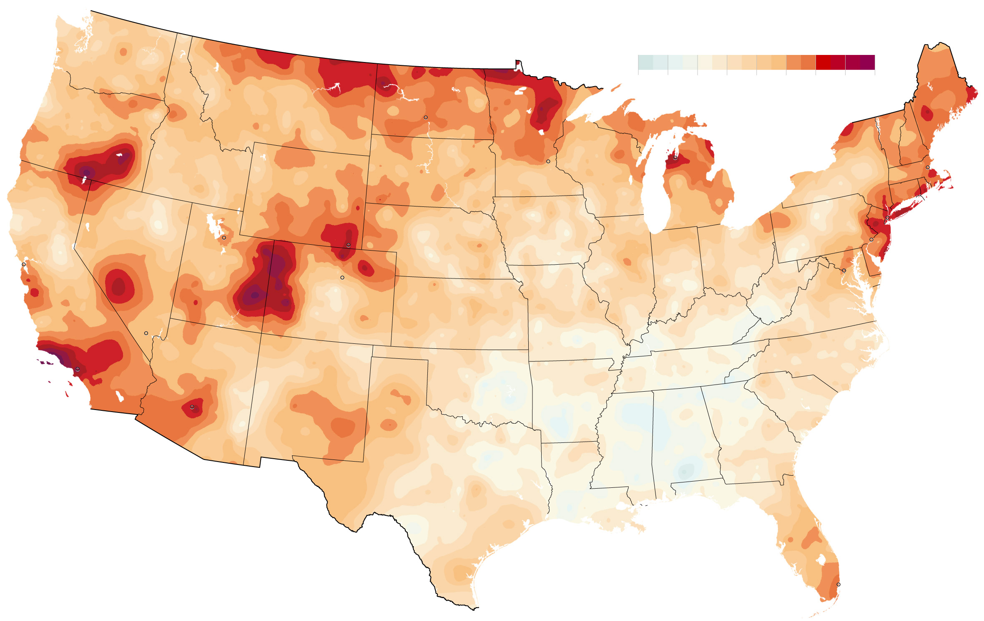

Statistical Analysis
Has temperature risen significantly in the years where data is available?
Null Hypothesis: The change in YOY monthly temperature has a mean that is not greater than zero at the 0.05 significance level
Hypothesis: The change in YOY monthly temperature has a mean that is significantly greater than zero at the 0.05 significance level
True
Has temperature dropped significantly in the years where data is available?
Null Hypothesis: The change in YOY monthly temperature has a mean that is not less than zero at the 0.05 significance level
Hypothesis: The change in YOY monthly temperature has a mean that is significantly less than zero at the 0.05 significance level
Notes:
ST

Slide 11
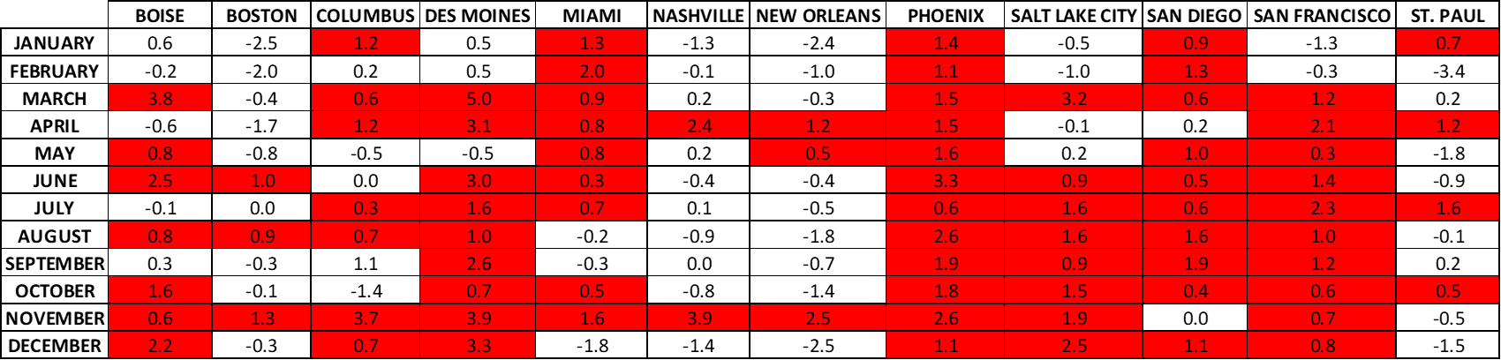
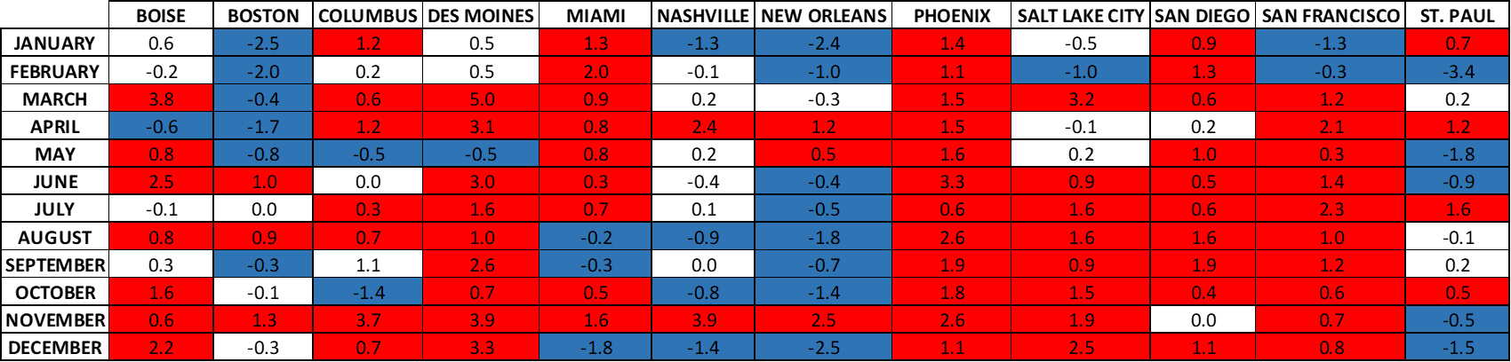
Statistical Analysis
Notes:
ST

Slide 12
Conclusions
https://screencast-o-matic.com/watch/cYeYVdynDA
Notes:
CB
In conclusion, based on all of this data, we will leave you with this:
Every city showed significant climate change for at least 6 months of the year from 1951 to 2017 (with a p value <0.05) where the majority of the cities showed significant warming. Only three cities had more significant cooling months compared to warming months (which were Boston, St. Paul Island (Alaska) and,surprisingly, New Orleans)
When plotting delta T, using 1951 as the baseline for all cities, you can see an upward trend in temperature over the 67 year period we analyzed.
Overall, each of the cities showed a positive increase in temperature change and based on the monthly data heatmaps there appears to be a seasonal shift for those cities that are most affected by climate change
Finally, as we can see here in this video, there appears to be an inflection point here, around 1980, where the data no longer bounces around baseline (or the 0 change in temperature), but it begins to steadily climb as we reach 2017
With 1951 being an arbitrary starting point, which was based on the data we were able to procure, there is some data verification that must be done: either using additional weather stations in a city or region as well as looking at data outside of the 67-year range we used. However, in the end, unfortunately, climate change is for real. Thank you for your time

